Slide 1

Leveraging predictability of deep learning techniques on financial time series forecasting
GITAM
(Deemed to be University)
School of Technology, Hyderabad
Department of Computer Science and Engineering
PROJECT BATCH NO. : P10-15 GUIDE NAME:-
NAME OF THE STUDENTS:- PROF. SARAT CHANDRA NAYAK
SRI VAISHNAVI VASA (HU21CSEN0100673)
LEENA DEEKOLLU (HU21CSEN0100741)
BINDU SRI (HU21CSEN0101184)

Slide 2
CONTENTS
INTRODUCTION
ABSTRACT
REVIEW OF LITERATURE SURVEY
PROBLEM STATEMENT

Slide 3
INTRODUCTION

Slide 4
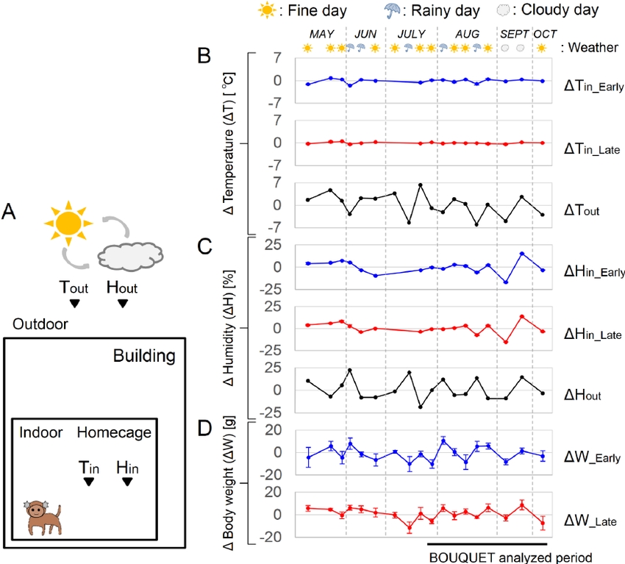
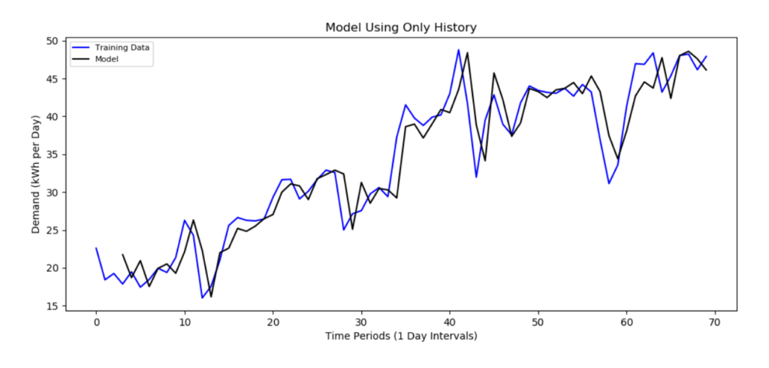
WHAT IS TIME SERIES DATA?
Time series data is a collection of data points that are recorded in order over time. Each data point is linked to a specific moment, like every minute, hour, day, or year.

Slide 5
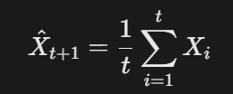
TIME SERIES FORECASTING
Time series forecasting is a data science technique that uses historical data to predict future values. It's used in many industries, including finance, marketing, sales, and retail, to predict things like sales numbers, stock prices, weather, and consumer demand.
For a time series X={X₁,X₂,...,X_{t}}, where each X_{t} is an observation at time t, the forecast for the next time period t+1 can be expressed as:
This equation indicates that the forecast X̂_{t+1} is simply the average of all past observations up to time t. This approach assumes that future values will follow the same distribution as past values and is particularly useful when the time series does not exhibit trends or seasonality.

Slide 6
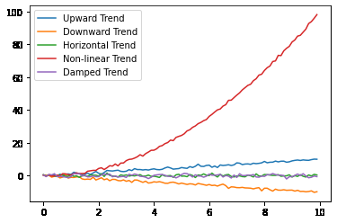
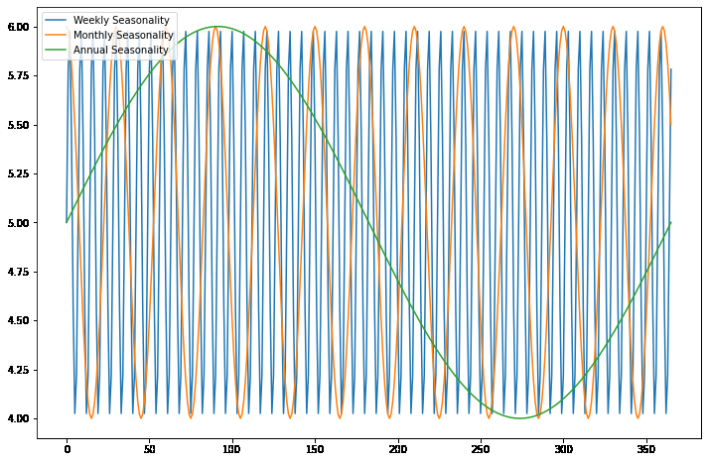
CHARACTERISTICS OF TIME SERIES DATA
TREND: Time series data may show long-term increases or decreases over time, known as trends.
SEASONALITY: Time series data can exhibit repeating patterns or cycles over specific periods, like daily, weekly, monthly, or yearly.
Source: https://www.geeksforgeeks.org/components-of-time-series-data/

Slide 7
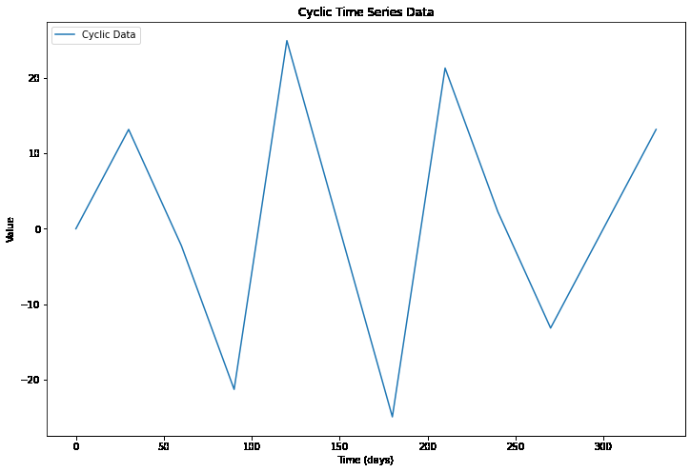
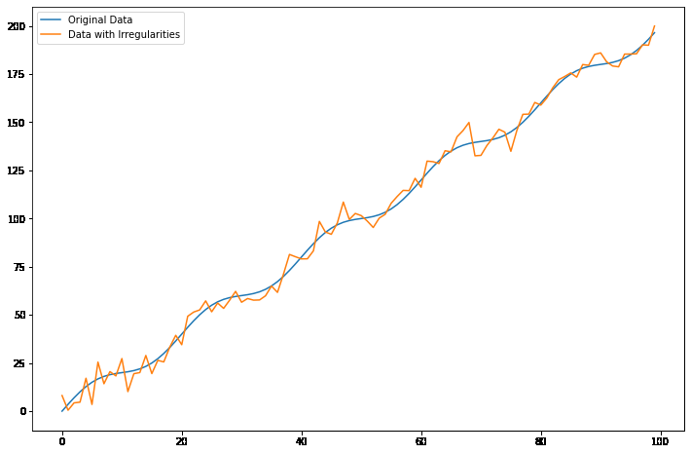
CYCLICITY: Cyclicity, on the other hand, refers to the repeated patterns or fluctuations that occur in the data over an unspecified time interval
IRREGULARITIES: Unexpected or unusual fluctuations in the data that do not follow the general pattern of the data.
Source: https://www.geeksforgeeks.org/components-of-time-series-data/

Slide 8
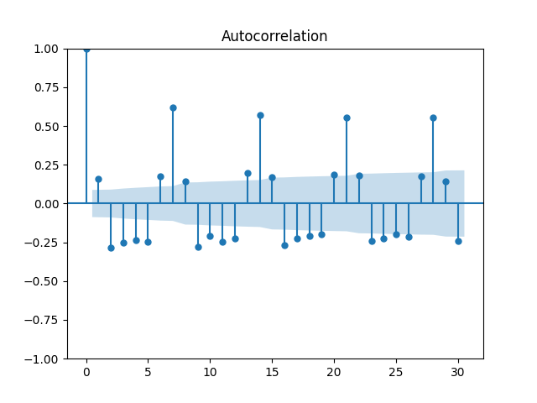
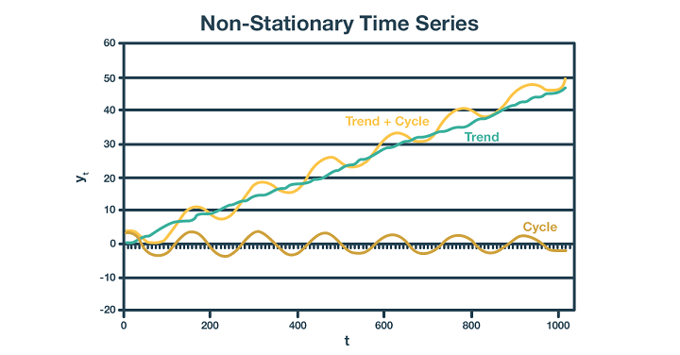
AUTOCORRELATION: It measures how closely related the values in the time series are to each other at different time lags
STATIONARITY: Property of a time series that describes when its statistical properties, like mean and variance, do not change over time.

Slide 9
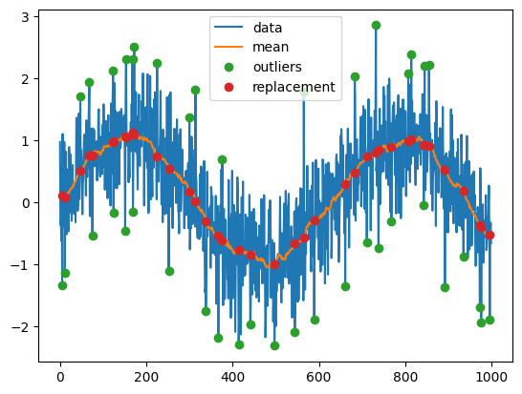
NOISE: Refers to random fluctuations or variations that are not due to an underlying pattern or trend. It is typically considered as any unpredictable and random variation in the data. The presence of noise can make it difficult to identify the underlying trend or pattern in the data, and therefore it is important to remove or reduce the noise before any further analysis.
OUTLIERS: Outliers in time series data are data points that are significantly different from the rest of the data points in the series. These can be due to various reasons such as measurement errors, extreme events, or changes in underlying data-generating processes.

Slide 10
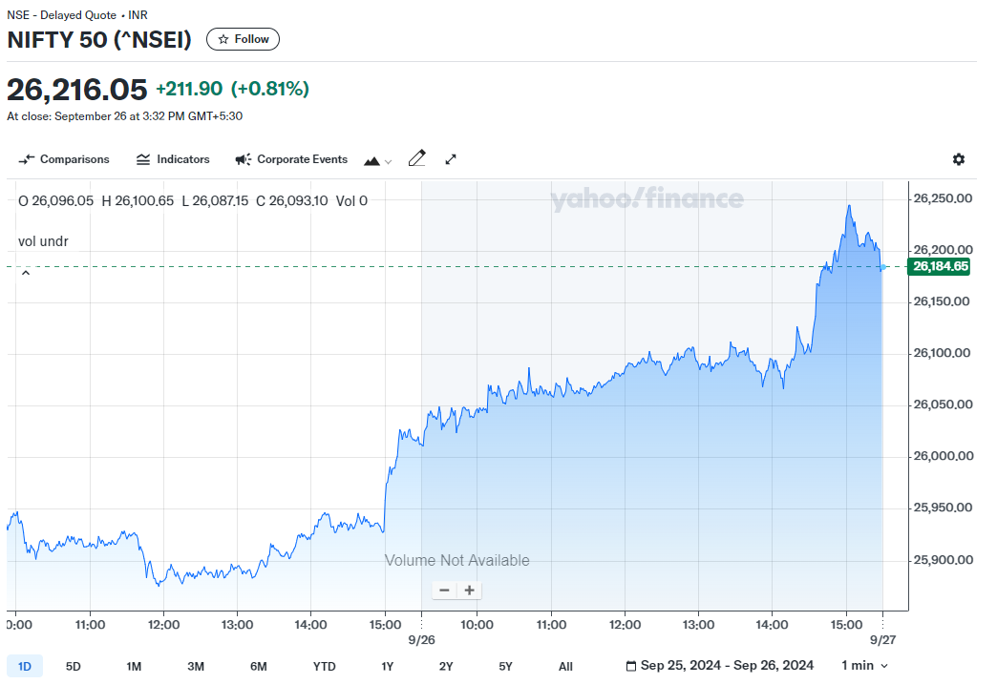
FINANCIAL TIME SERIES
A financial time series is a sequence of financial data points, like stock prices, interest rates, or exchange rates, recorded at regular time intervals. It shows how these values change over time, helping investors and analysts track and predict market trends.
Source: Yahoo finance - NIFTY 50 Chart

Slide 11
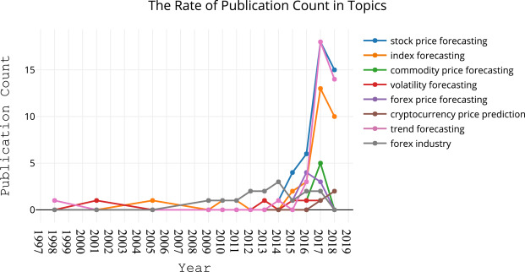
FINANCIAL TIME SERIES FORECASTING
Financial time series forecasting is the process of predicting future financial data, such as stock prices or interest rates, based on past data patterns. It helps investors and analysts make informed decisions by estimating how these values might change over time.
Research in this field started almost 40 years back and since then there have been multiple advancements in this field.

Slide 12
ABSTRACT

Slide 13
Financial time series forecasting is undoubtedly the top choice of computational intelligence for finance researchers in both academia and the finance industry due to its broad implementation areas and substantial impact. Machine Learning (ML) researchers have created various models, and a vast number of studies have been published accordingly. As such, a significant number of surveys exist covering ML studies on financial time series forecasting.
Lately, Deep Learning (DL) models have appeared within the field, with results that significantly outperform their traditional ML counterparts. Even though there is a growing interest in developing models for financial time series forecasting, there is a lack of review papers that solely focus on DL for finance. Hence, the motivation of this research is to provide a comprehensive literature review of DL studies on financial time series forecasting implementation. We try to envision the future of the field by highlighting its possible setbacks and opportunities for the benefit of interested researchers. We aim to choose the best algorithm for overcoming existing ambiguities in the chosen dataset and aligning with the future objectives outlined in prior studies.
.

Slide 14
REVIEW OF
LITERATURE SURVEY

Slide 15
Financial time series forecasting with deep learning :
A systematic literature review: 2005–2019
This paper focuses on providing a comprehensive literature review of deep learning (DL) models used for financial time series forecasting.
It categorizes existing studies based on their application areas (e.g., index, forex, and commodity forecasting) and the DL models employed, such as CNNs, DBNs, and LSTMs.
The paper addresses the gap in review articles specific to DL in finance and discusses future challenges and opportunities in the field.
The paper reviewed 200 studies on financial time series forecasting using deep learning models.
These studies span a wide variety of datasets, including indices like the S&P 500, Chinese stock markets, and other financial assets such as stocks, forex, and commodities.
DL models have outperformed their traditional ML counterparts.
Lack of review papers that solely focus on DL for finance

Slide 16
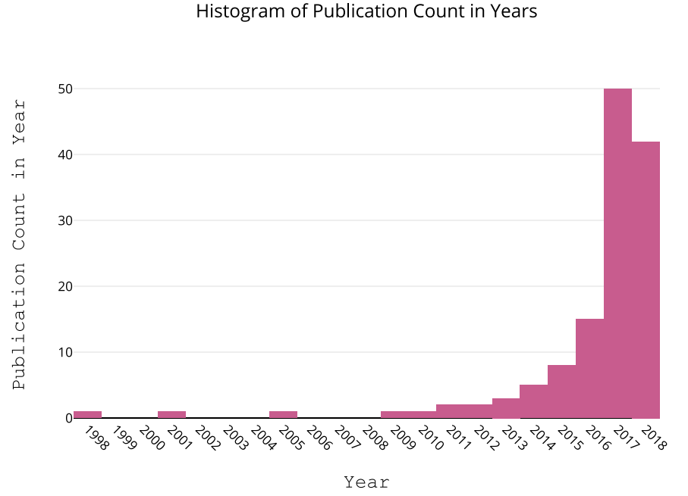
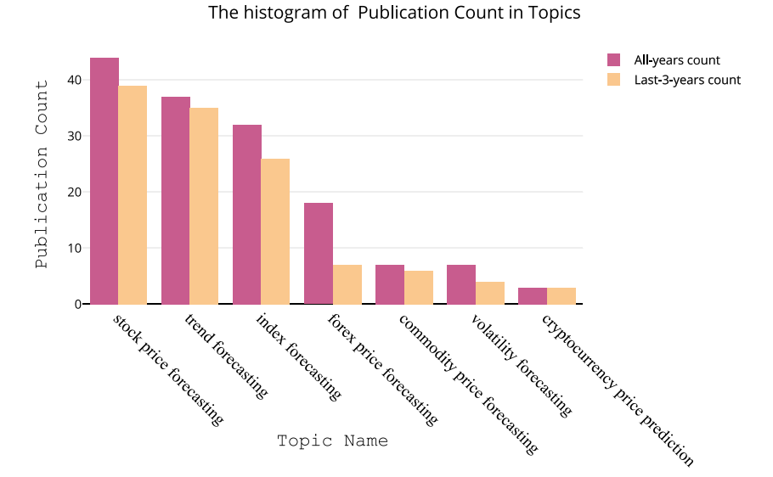
Source: https://www.sciencedirect.com/science/article/pii/S1568494620301216

Slide 17
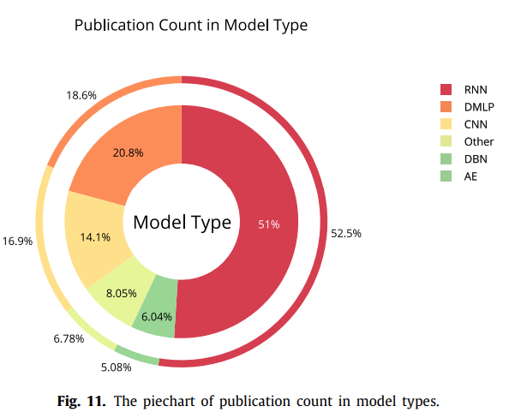
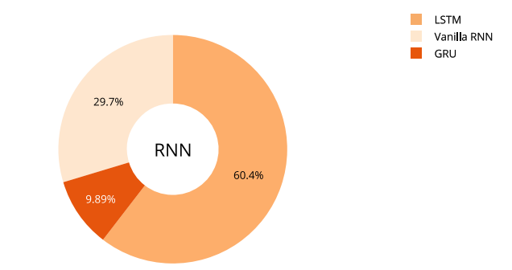
Source: https://www.sciencedirect.com/science/article/pii/S1568494620301216

Slide 18
The paper concludes that:
- Stock/index forecasting has always had the most interest among all asset groups.
- Financial time series forecasting research on cryptocurrencies is a hot topic
- Because this topic is relatively new, we might see more studies and implementations in the near future due to high expectations and promising rewards
- Oil price prediction is crucial due to its tremendous effect on world economic activities and planning.
- Meanwhile, gold is considered a safe investment and almost every investor, at one time, considers allocating some portion of their portfolio for gold-related investments. In times of political uncertainty, many people turn to gold to protect their savings. Although we did not encounter a noteworthy study for gold price forecasting, due to its historical importance, there might be opportunities in this area in years to come.
- The dominance of RNN-based models for price/trend prediction will probably not disappear anytime soon, mainly due to their easy adaptation to most asset forecasting problems.
- Some enhanced versions of the original LSTM or RNN models, generally integrated with hybrid learning systems, are now becoming more common.
- 2-D CNN implementations of financial forecasting problems by converting the time series into an image-like data type
- Financial time series forecasting has not been investigated for Generative Adversarial Network (GAN), and Capsule networks, Graph CNN models yet
- Deep RL and agent-based models offer great opportunities for researchers

Slide 19
Deep learning models for price forecasting of financial time series: A review of recent advancements: 2020–2022
The paper primarily focuses on providing a comprehensive literature review of deep learning models used for price forecasting in financial time series, specifically examining advancements from 2020 to 2022.
It presents an analysis of different DL architectures, including models such as Transformers, GANs, graph neural networks (GNNs), and deep quantum neural networks (DQNNs).
The review highlights the practical applications, advantages, and disadvantages of these models, and suggests potential future research directions in the field.
The paper considered a total of 72 research studies in its review of deep learning models for price forecasting of financial time series.
.

Slide 20
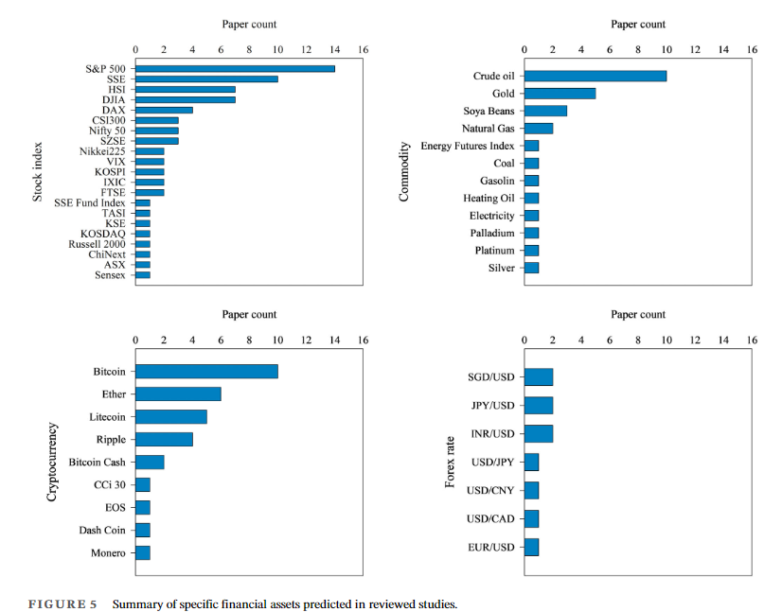
Source: https://wires.onlinelibrary.wiley.com/doi/epdf/10.1002/widm.1519

Slide 21
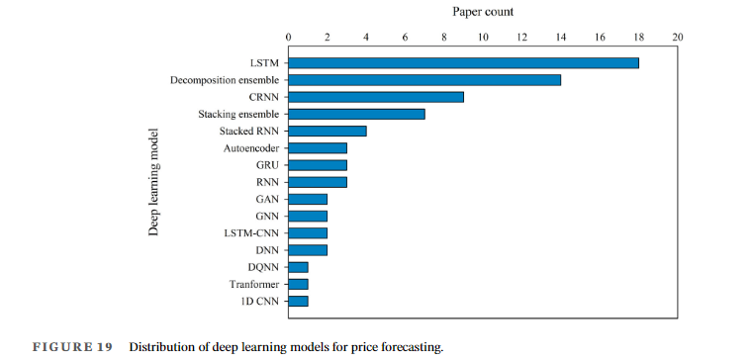
Source: https://wires.onlinelibrary.wiley.com/doi/epdf/10.1002/widm.1519

Slide 22
The conclusion of this research paper emphasizes the growing importance of deep learning (DL) models in financial time series forecasting, particularly over the past three years.
It notes that DL models have demonstrated significant potential in capturing complex patterns in financial data, outperforming traditional machine learning models.
However, the paper also highlights several challenges, such as the need for larger datasets, model interpretability, and high computational costs.
FUTURE RESEARCH DIRECTIONS-:
Exploring more complex DL models such as Graph Neural Networks (GNNs) and deep reinforcement learning for financial forecasting.
Investigating ensemble learning methods and decomposition techniques to improve prediction accuracy.
Expanding forecasting from point prediction to interval prediction for better risk management.
Addressing the impact of data volume on model performance and considering the validity of decomposition ensembles

Slide 23
This paper focuses on providing a comprehensive literature review of deep learning (DL) models used for financial time series forecasting.
It categorizes existing studies based on their application areas (e.g., index, forex, and commodity forecasting) and the DL models employed, such as CNNs, DBNs, and LSTMs.
The paper addresses the gap in review articles specific to DL in finance and discusses future challenges and opportunities in the field.
The paper reviewed 200 studies on financial time series forecasting using deep learning models.
These studies span a wide variety of datasets, including indices like the S&P 500, Chinese stock markets, and other financial assets such as stocks, forex, and commodities.
DL models have outperformed their traditional ML counterparts.
Lack of review papers that solely focus on DL for finance

Slide 24
Financial applications of machine learning:
A literature review [2023]
The paper focuses on providing a systematic literature review of machine learning and deep learning applications in various financial domains, including stock markets, portfolio management, cryptocurrency, foreign exchange markets, financial crises, and bankruptcy and insolvency.
It analyzes 126 selected articles and examines the characteristics of data, features used for model training, and performance evaluation metrics for addressing financial problems.
The paper considered datasets from various financial domains, including:
Stock Market Data: Historical prices and returns of stocks and indices (e.g., S&P 500, NASDAQ).
Cryptocurrency Data: Prices of cryptocurrencies like Bitcoin and Ethereum.
Foreign Exchange Markets: Currency exchange rates.
Portfolio Management: Stock prices and volumes for portfolio optimization.
Financial Crises and Bankruptcy: Economic indicators and data related to market crashes and financial distress.

Slide 25
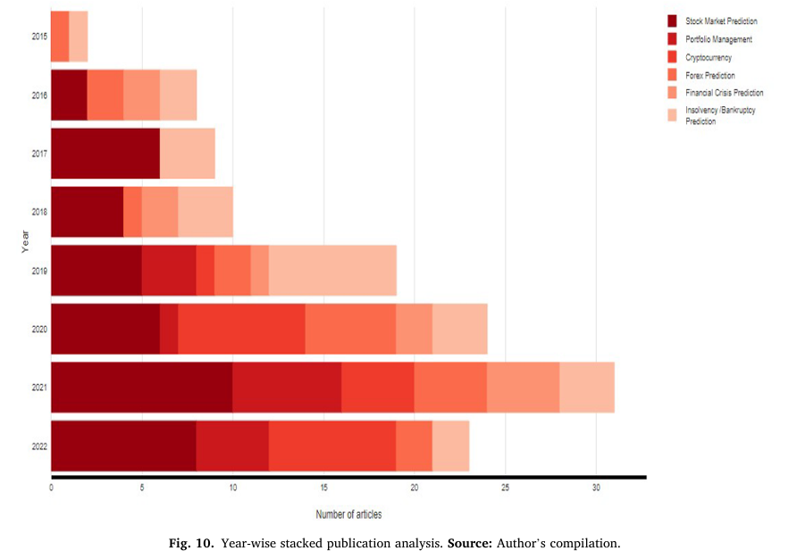
Source: Financial applications of machine learning: A literature review by Cheng Zhang, Nilam Nur Amir Sjarif, Roslina Ibrahim

Slide 26
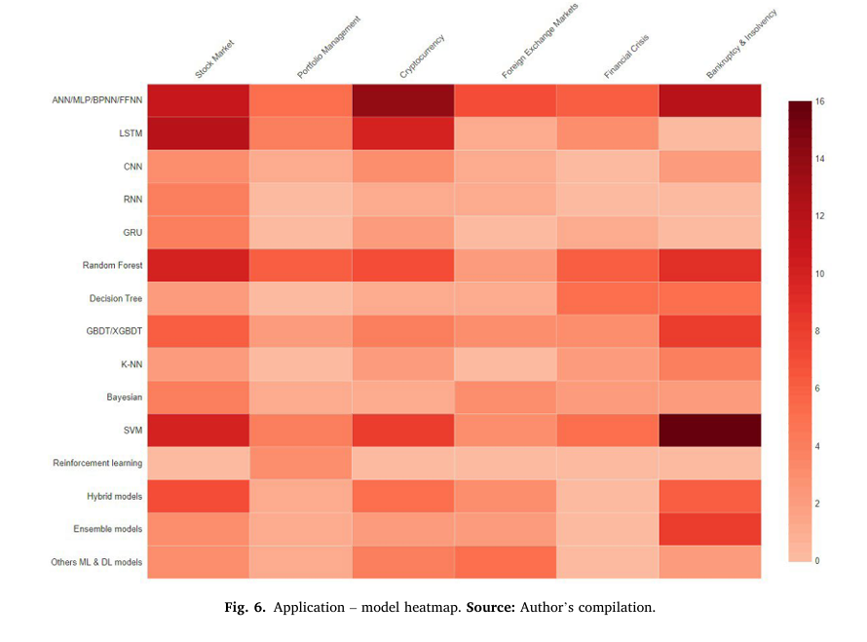
Source: Financial applications of machine learning: A literature review by Cheng Zhang, Nilam Nur Amir Sjarif, Roslina Ibrahim

Slide 27
The conclusion of the paper emphasizes the significant impact of machine learning and deep learning in various financial applications, highlighting the following key points:
1. Advancements in Techniques: There have been considerable advancements in machine learning techniques applied to financial problems, showcasing improved performance across different domains.
2. Challenges: Despite the progress, challenges remain in terms of data quality, model interpretability, and the need for more robust validation methods.
3. Research Gaps: The review identifies gaps in the literature, such as the need for more comprehensive studies on hybrid models and the exploration of emerging areas like cryptocurrency and reinforcement learning in portfolio management.
4. Future Directions: The paper suggests potential future research directions, including the integration of social media sentiment analysis, improved feature selection methods, and the application of novel machine learning techniques to enhance predictive accuracy.

Slide 28
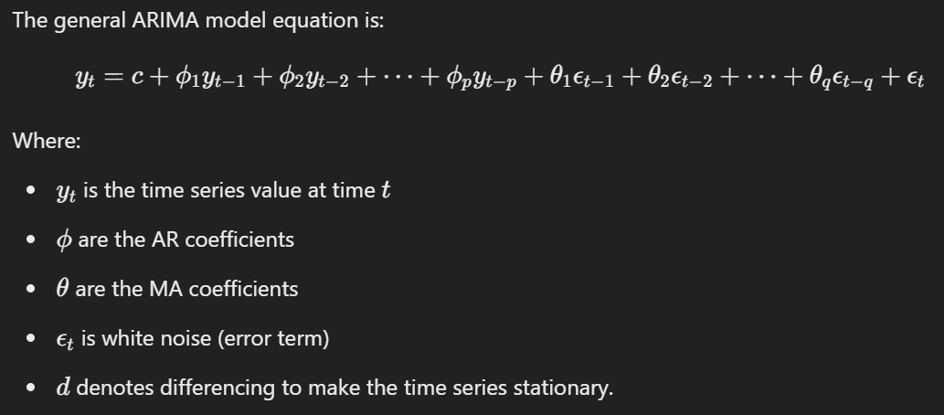
COMMONLY USED MODELS
ARIMA
ARIMA is a widely used statistical model for analyzing and forecasting time series data. It combines AutoRegression (AR), Differencing (I), and Moving Average (MA) to handle trends and seasonality in time series.
ARIMA(p, d, q) where:
p = Order of autoregression (AR)
d = Number of differences (I)
q = Order of moving average (MA)

Slide 29
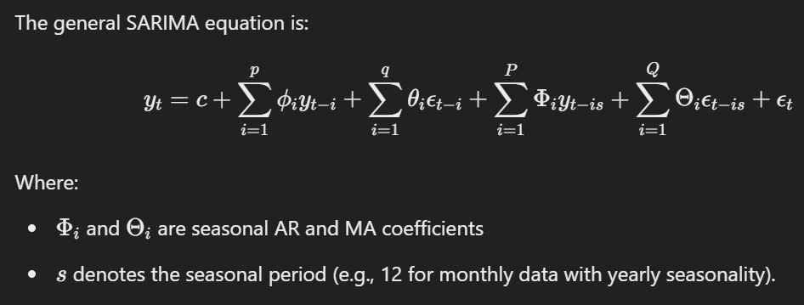
SARIMA
SARIMA extends ARIMA by adding seasonal components to account for patterns that repeat over a fixed period (seasonality).
SARIMA(p, d, q)(P, D, Q, s) where:
p,d,q are as in ARIMA
P,D,Q represent the seasonal part orders of AR, differencing, and MA
s is the length of the seasonal cycle

Slide 30
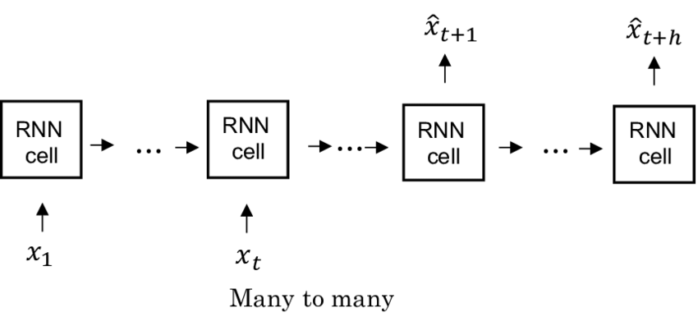
RNN
Recurrent Neural Networks (RNNs) are designed to handle sequential data, making them suitable for time series forecasting. They use feedback loops to process input sequences and maintain a hidden state that captures information from previous time steps.
Hidden State: RNNs maintain a hidden state hth_tht​ that updates at each time step ttt based on the current input xtx_txt​ and the previous hidden state ht−1h_{t-1}ht−1​.
Sequential Processing: The hidden state passes information from one time step to the next, capturing dependencies between the current and previous inputs.
Output: At each time step, the RNN produces an output yty_tyt​ based on the hidden state
Backpropagation Through Time (BPTT): During training, RNNs use BPTT to update weights by propagating errors backward through the sequence.

Slide 31
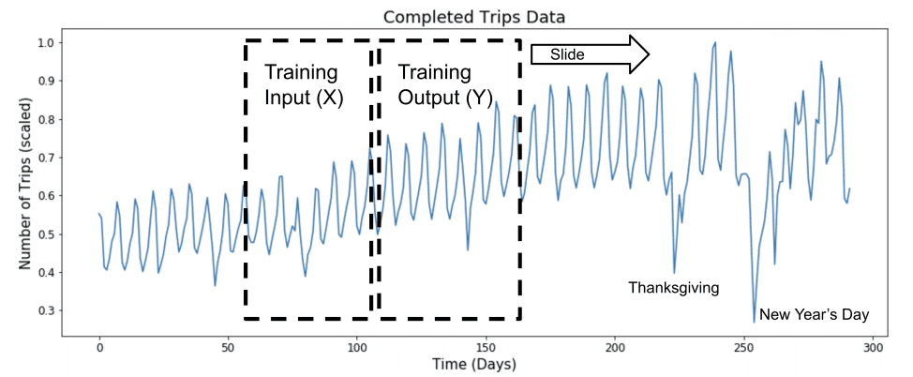
LSTM
LSTM (Long Short-Term Memory) is a type of recurrent neural network (RNN) designed to capture long-term dependencies in sequential data, making it highly effective for time series forecasting.
Memory Cells: LSTM units contain memory cells that maintain information over time, which helps the model remember patterns in the time series data.
Gates: LSTM uses three gates to control the flow of information: Forget Gate, Input Gate, Output Gate
Cell State Update: The cell state is updated based on the forget and input gates. It allows LSTM to carry forward relevant information and discard irrelevant data.

Slide 32
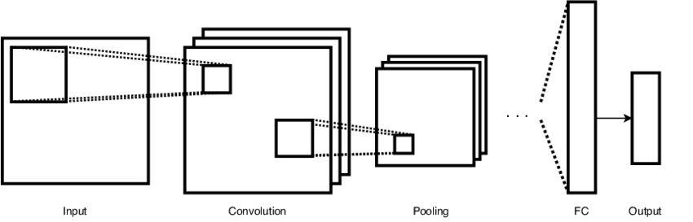
CNN
Convolutional Neural Networks (CNNs), traditionally used for image processing, are also effective for time series forecasting by capturing local patterns and trends in the data through convolution operations.
Convolution Layers: CNNs use filters to slide over input data, identifying local patterns like trends or seasonality.
Pooling: Pooling layers (e.g., max-pooling) reduce dimensionality, preserving key features while minimizing noise.
Feature Learning: Stacked convolutional layers extract higher-level, abstract features from the time series.
Fully Connected Layer: Flattened features are fed into a fully connected layer for final prediction.
Non-Linearity: Activation functions like ReLU introduce non-linearity, helping the model learn complex patterns.

Slide 33
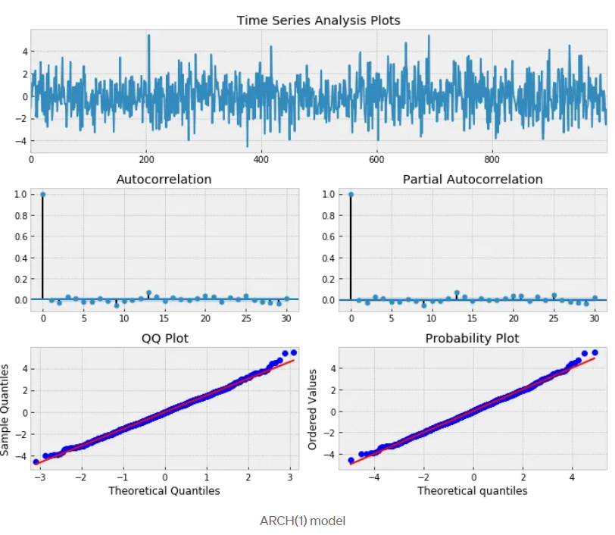
ARCH
ARCH is an Autoregressive model with Conditional Heteroskedasticity .
“The ARCH process introduced by Engle (1982) explicitly recognizes the difference between the unconditional and the conditional variance allowing the latter to change over time as a function of past errors.”
Autoregressive: The current value can be expressed as a function of the previous values i.e. they are correlated.
Conditional: This informs that the variance is based on past errors.
Heteroskedasticity: This implies the series displays unusual variance (varying variance).
Source:https://medium.com/@ranjithkumar.rocking/time-series-model-s-arch-and-garch-2781a982b448

Slide 34
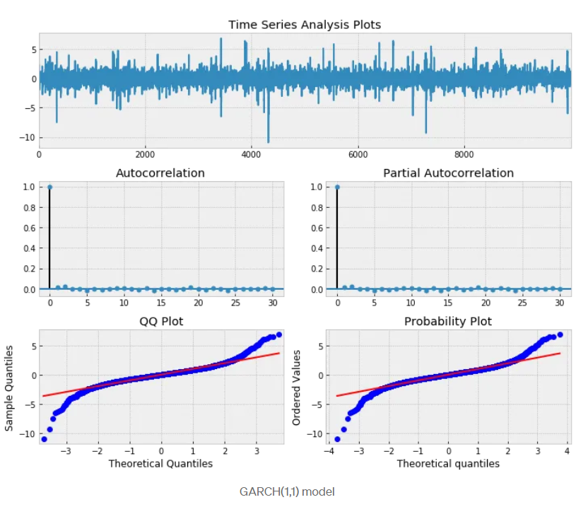
GARCH
GARCH (Generalized Autoregressive Conditional Heteroskedasticity) is a statistical model used to forecast time series data, particularly for financial data where volatility varies over time (heteroskedasticity).
In a GARCH model, the conditional variance of the error term at time ttt is expressed as a function of past squared residuals and past variances.
Source:https://medium.com/@ranjithkumar.rocking/time-series-model-s-arch-and-garch-2781a982b448

Slide 35
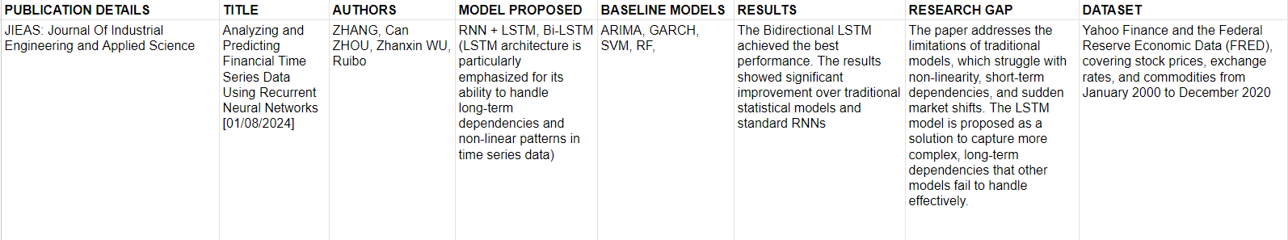
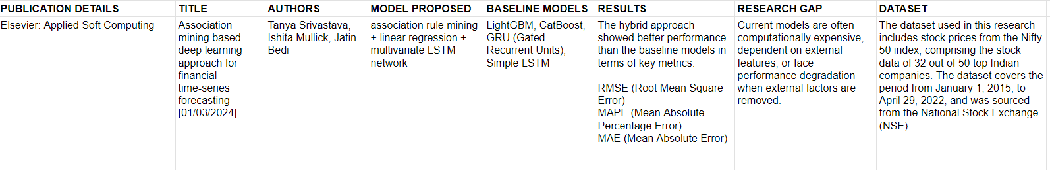

Slide 36
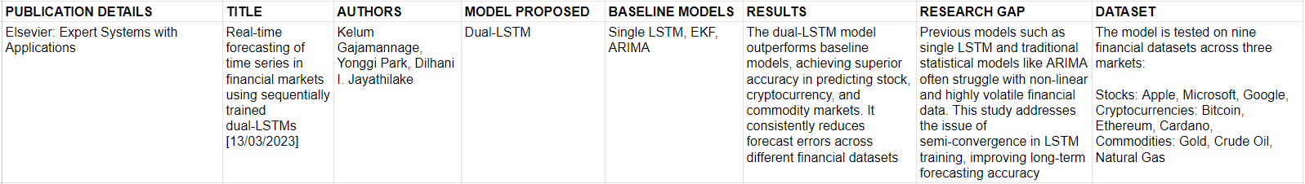
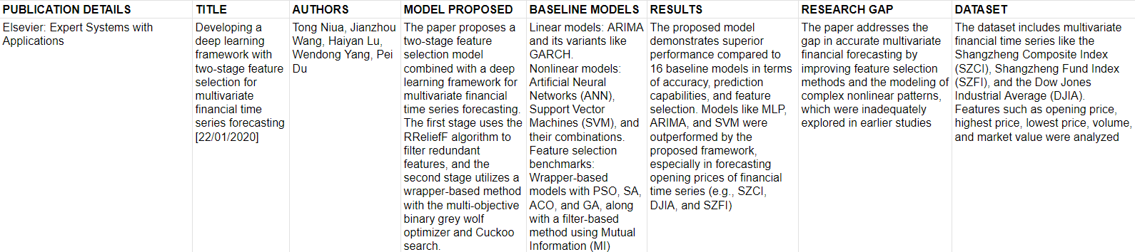

Slide 37
PROBLEM STATEMENT

Slide 38
PROBLEMS AND CHALLENGES
Data Quality and Availability: Forecasting is often hindered by missing data or gaps in historical records, which can lead to inaccurate predictions. The quality and relevance of the data are crucial to producing reliable forecasts.
Nonstationarity and Structural Breaks: Financial time series often exhibit nonstationarity, where statistical properties change over time due to factors like market regulations or global events. Structural breaks can further disrupt forecasting models, impacting their accuracy.
Complexity and Nonlinearity: Financial markets are complex and often feature nonlinear relationships between variables. Capturing these nonlinearities requires advanced models like neural networks or ensemble methods, as linear models may not fully capture the dynamics.

Slide 39
Volatility and Uncertainty: High volatility and sudden price fluctuations in financial markets pose significant forecasting challenges. Accounting for this uncertainty is essential to improve prediction accuracy.
Overfitting and Generalization: Models risk overfitting to training data, performing poorly on unseen data. Balancing model complexity with generalization is key to ensuring reliable real-world performance.
Evaluation and Comparison: Comparing forecasting models is complex due to varying evaluation metrics and benchmarks. Developing standardized evaluation frameworks is important for fair comparisons and effective decision-making.
Practical Challenges: Real-world deployment of forecasting models faces practical issues, such as data latency, model updates, retraining, and integrating forecasts into business processes.

Slide 40
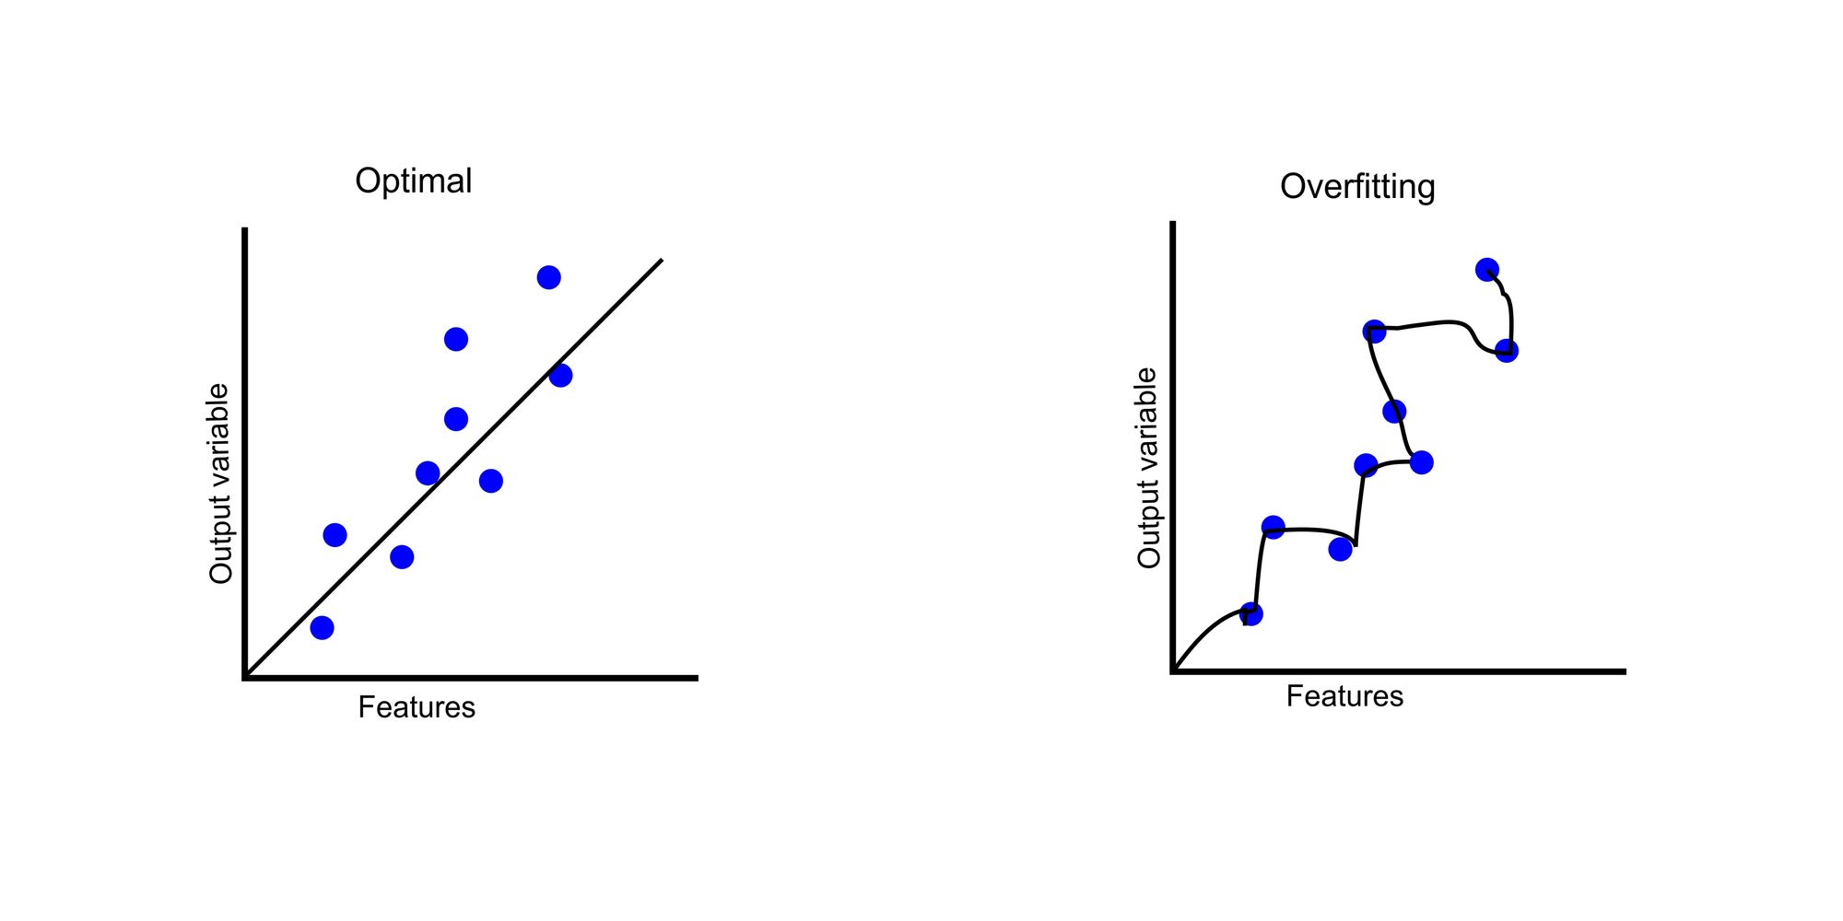
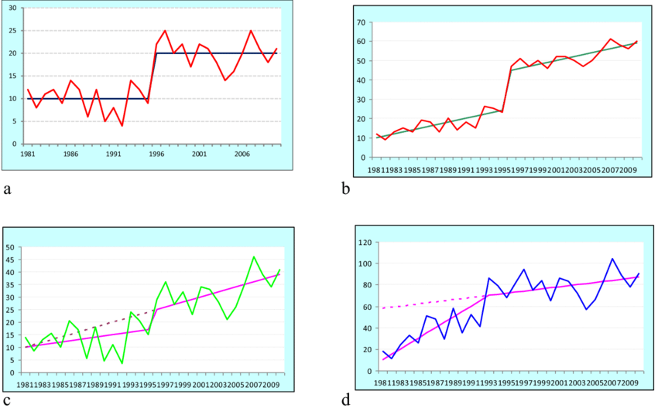
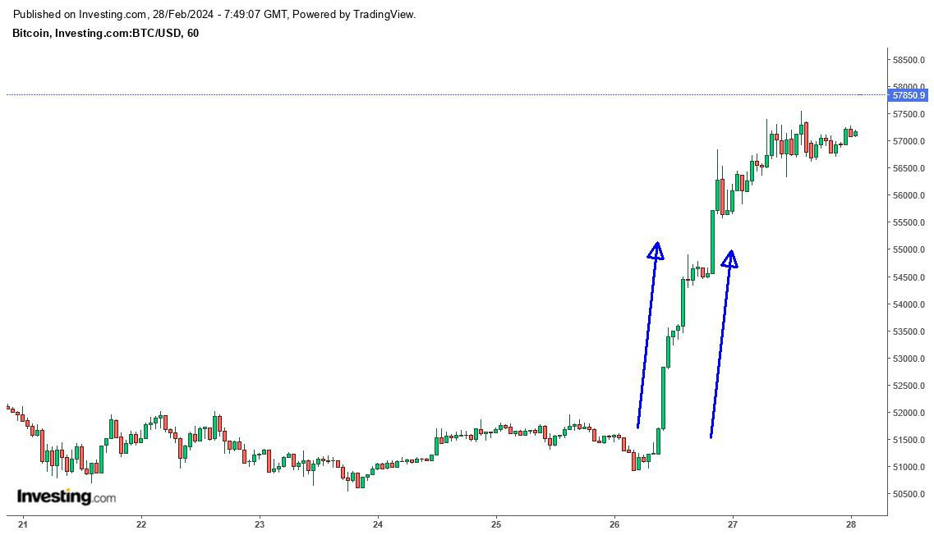
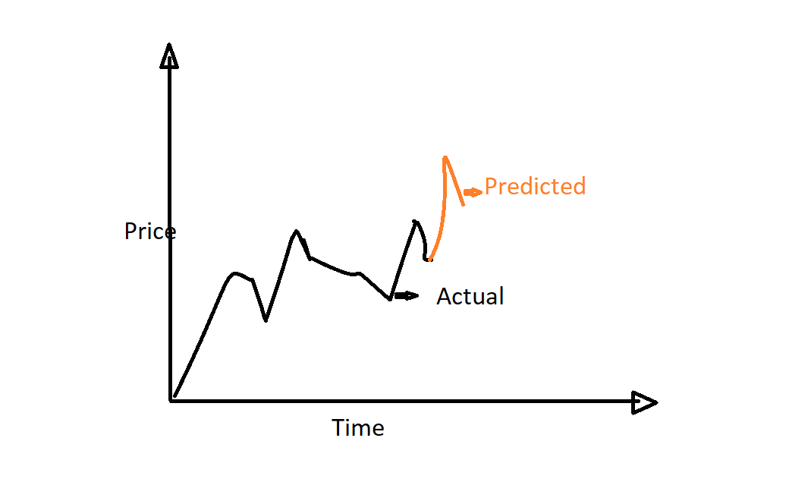
OVERFITTING
STRUCTURAL BREAKS
LAGGING PROBLEMS
UNCERTAINTY

Slide 41
LAGGING PROBLEM
Delayed Reaction to Market Changes: Lagging indicators reflect past events, confirming trends only after they occur. This delay can cause missed opportunities in timely investment and risk management, as decisions are based on outdated data.
Inefficient Decision-Making: Relying on historical data for forecasting leads to reactive rather than proactive decisions. In fast-moving markets, this can result in suboptimal outcomes since new information is not accounted for promptly.

Slide 42
Overfitting and Model Complexity: Using lagged variables can make models overly complex, risking overfitting by capturing noise rather than true trends. This reduces the model's effectiveness on new data.
Nonstationarity and Structural Breaks: Lagged data complicates dealing with nonstationary series, where statistical properties change over time. Structural breaks can further diminish the relevance of historical data, complicating accurate forecasting.
Limited Use of Leading Indicators: Over-reliance on lagging indicators may cause analysts to miss leading indicators, which provide foresight into future trends, potentially leading to better forecasts and strategic decisions.
Impact on Risk Management: Lagging data can impair risk management by failing to reflect current market conditions, potentially exposing financial institutions to unforeseen risks.

Slide 43
PROBLEM STATEMENT
Financial time series forecasting faces significant challenges that can compromise the accuracy and reliability of predictions. Issues such as data quality, including missing values and gaps in historical records, pose considerable hurdles for forecasting models. Additionally, nonstationarity in financial data, often caused by structural breaks from market regulations or global events, complicates the modeling process. The inherent volatility and uncertainty of financial markets further necessitate advanced modeling techniques capable of capturing the complex, nonlinear relationships among variables, as traditional linear models may not adequately reflect the dynamics of these systems.
Despite the increasing interest in deep learning (DL) techniques, there is a notable lack of comprehensive literature reviews focusing on their implementation and effectiveness in financial time series forecasting. This research aims to fill this gap by systematically reviewing existing DL methodologies, highlighting their strengths and weaknesses, and evaluating their predictability in overcoming common challenges such as overfitting and model generalization. By leveraging the predictive capabilities of deep learning techniques, this study seeks to enhance forecasting accuracy, ultimately contributing to improved decision-making processes within the finance industry.

